Slide 1

Data Science Fundamentals
Project 1
Marwa Salah
Sales Predictions

Slide 2
Project Description
This project focuses on reading, cleaning, visualizing and finally building prediction models for a Sales dataset predicting Sales Amoutns.
Packages Used:
Numpy
Pandas
Matplotlib
Seaborn
Sklearn
Algorithms Applied:
Linear Regression
Decision Tress Regression
Bagging Regression
Random Forest Regression

Slide 3
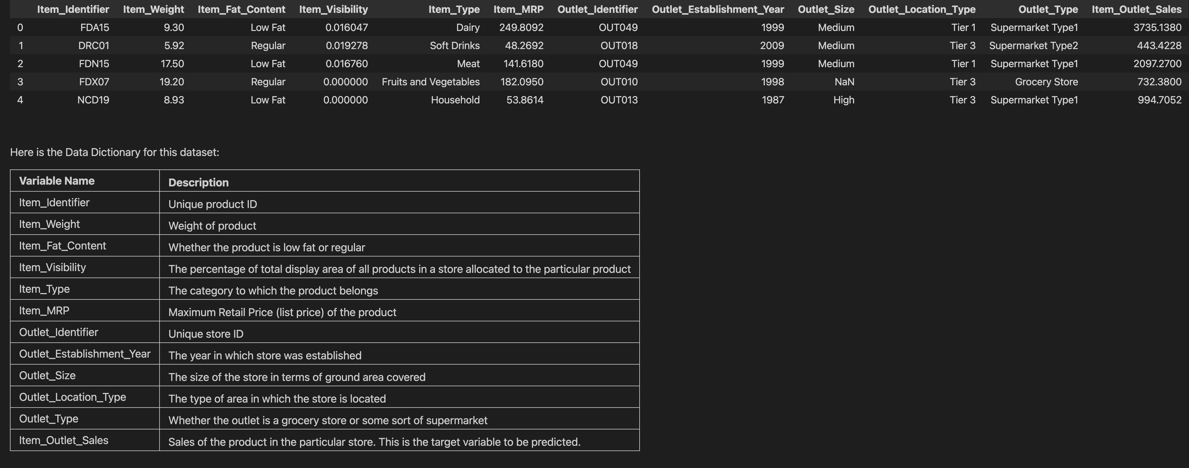
Data Description
Dataset Overview:
- In this project the dataset featured sales for items that are spread over different Types and across several outlets each of which has a type and a location type. The data also includes several properties about each item such as Fat Content & Weight and finally the Items’ MRP

Slide 4
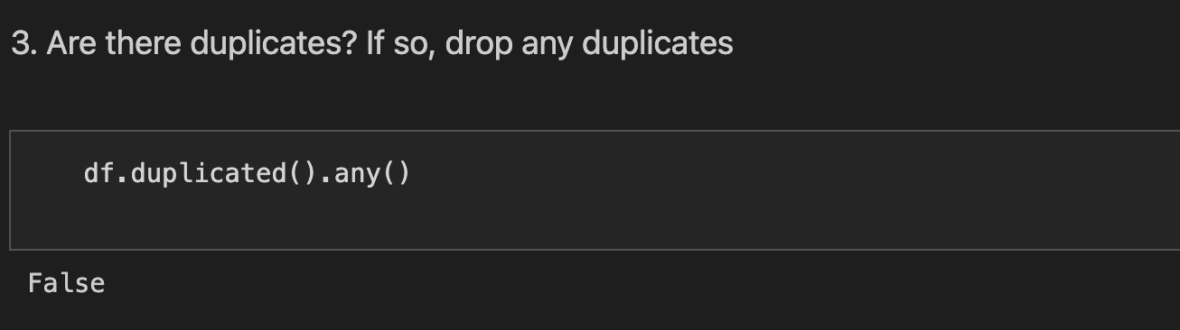
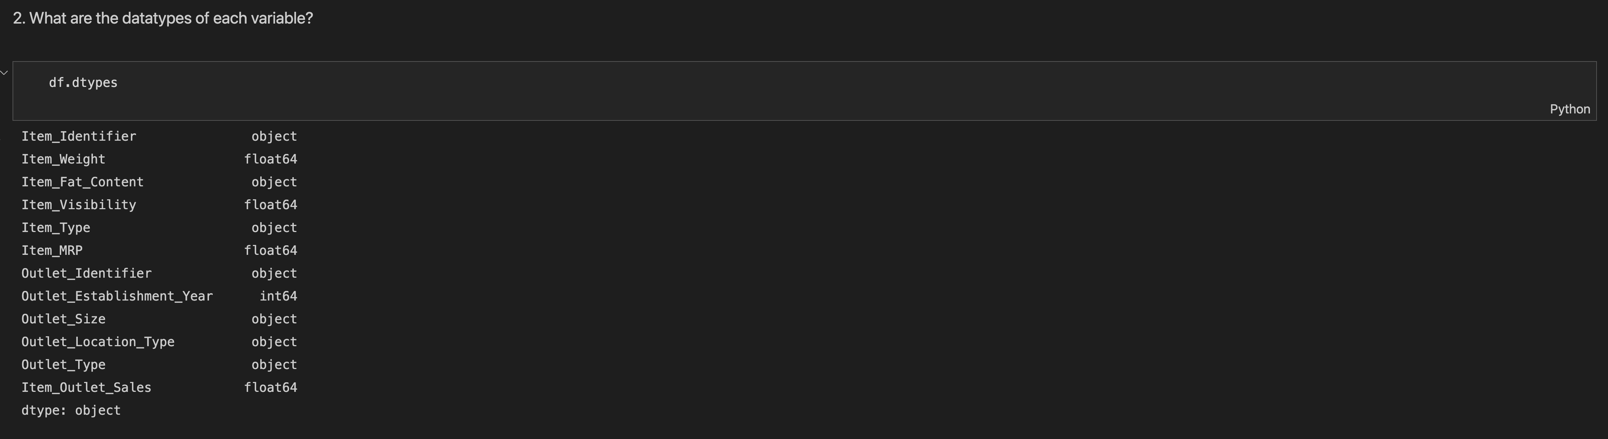
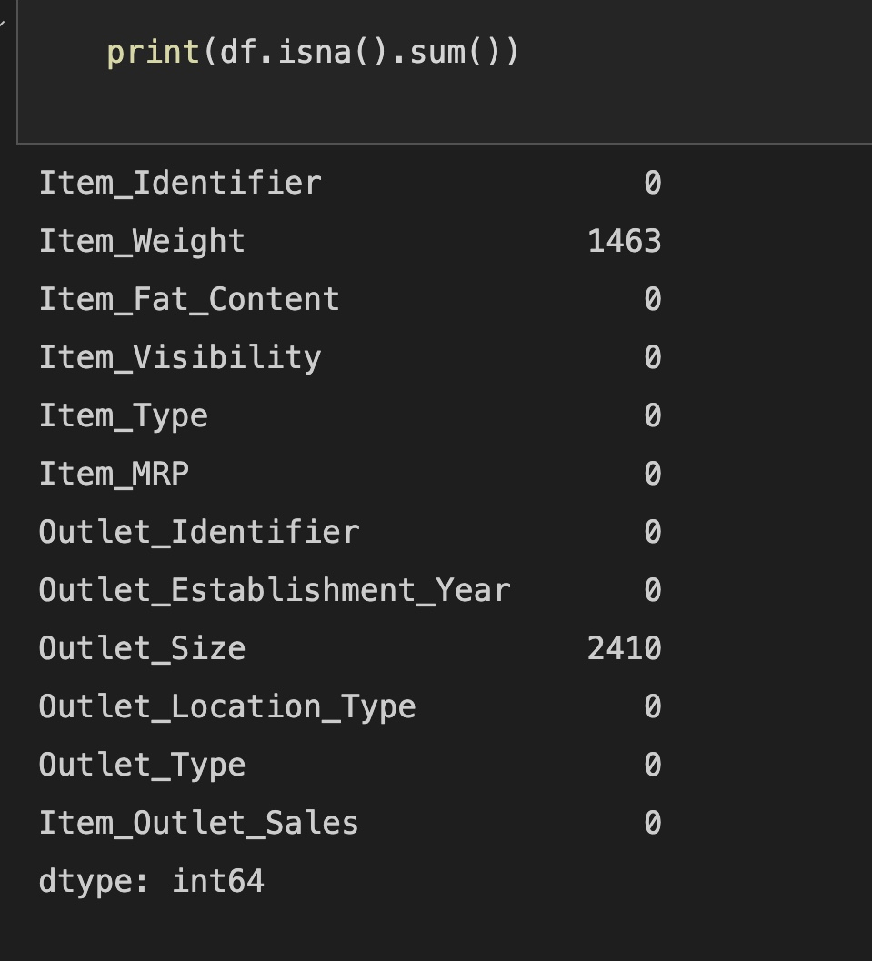
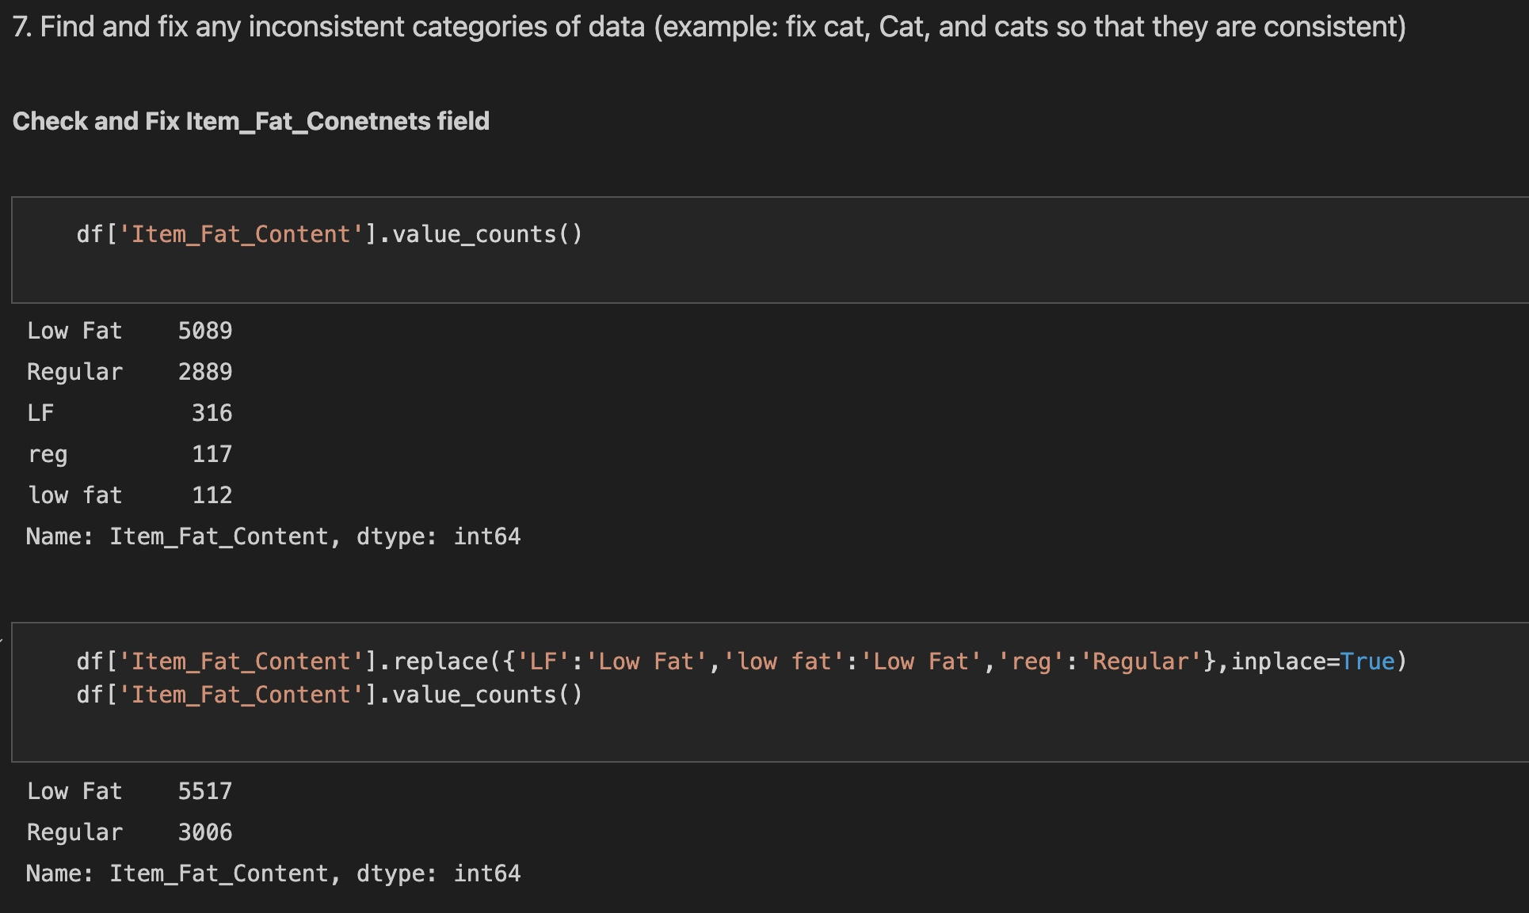
Data Cleaning
Original Dataset Shape:
Prior to cleaning
- Number of Rows: 8523
- Number of Columns: 12
Original Status of Data
No Duplicates
Nulls Existed in 2 Columns:
Item_Wright
Outlet_Size
Inconsistencies existed in categorical columns; namely:
Item_Fat_Content

Slide 5
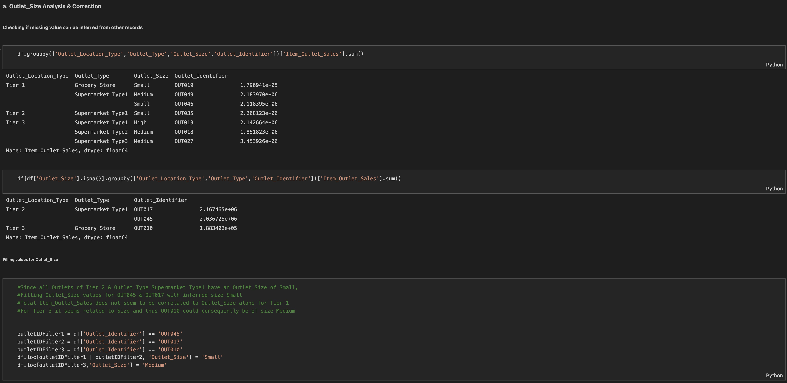
Data Cleaning Cont.
Outlet_Size:
To Fix the missing values in this column, two approaches were compared
Using Simple Imputer
Inferring Value Manually based on Existing Data in the Dataset

Slide 6
Data Cleaning Cont.
Outlet_Size Cont:
Inferring Values
The Following was observed:
All Existing Outlets of Tier 2 & Supermarket Type 1 has an Outlet_Size = Small
For all existing outlets Item_Outlet_Sales did not appear to be correlated to Outlet_Size alone
For Tier 3, Item_Outlet_Sales seems to be correlated with Outlet_Size thus the 3rd Outlet_Size missing value was assigned value of Medium based on this reasoning.

Slide 7
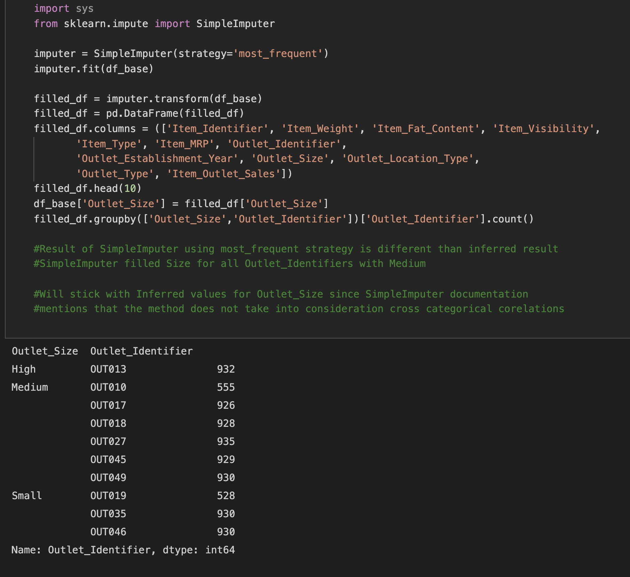
Data Cleaning Cont.
Outlet_Size Cont:
Using Simple Imputer
Simple Imputer using the most frequent strategy populated the Outlet_Size value for all missing ones with value Medium
Since its documentation mentions that it does not take into consideration cross categorical correlations, I opted to stick with the inferred values based on manual data observation for imputing these missing values.

Slide 8
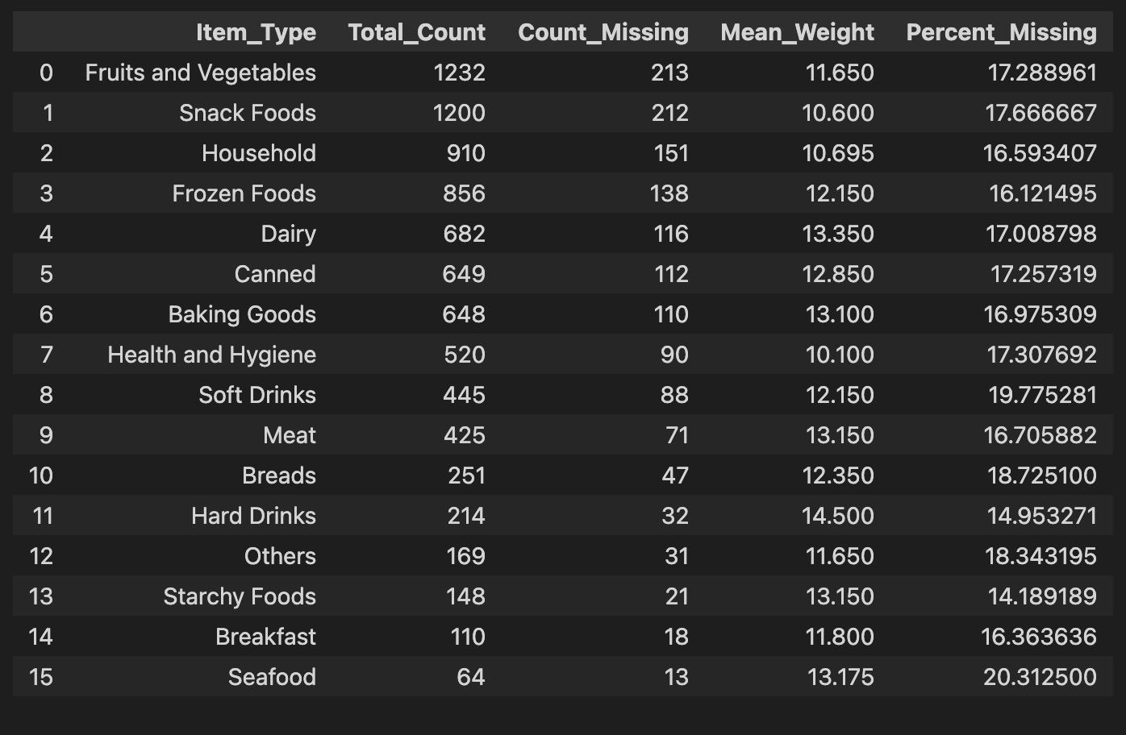
Data Cleaning Cont.
Item_Weight:
Observing Values
Attempted to observe values to infer any meaningful correlation and created and summarized dataframe with information on Item_Weight as it relates to Item_Types or to serve as guide for maybe dropping records but this did not yield any actionable results

Slide 9
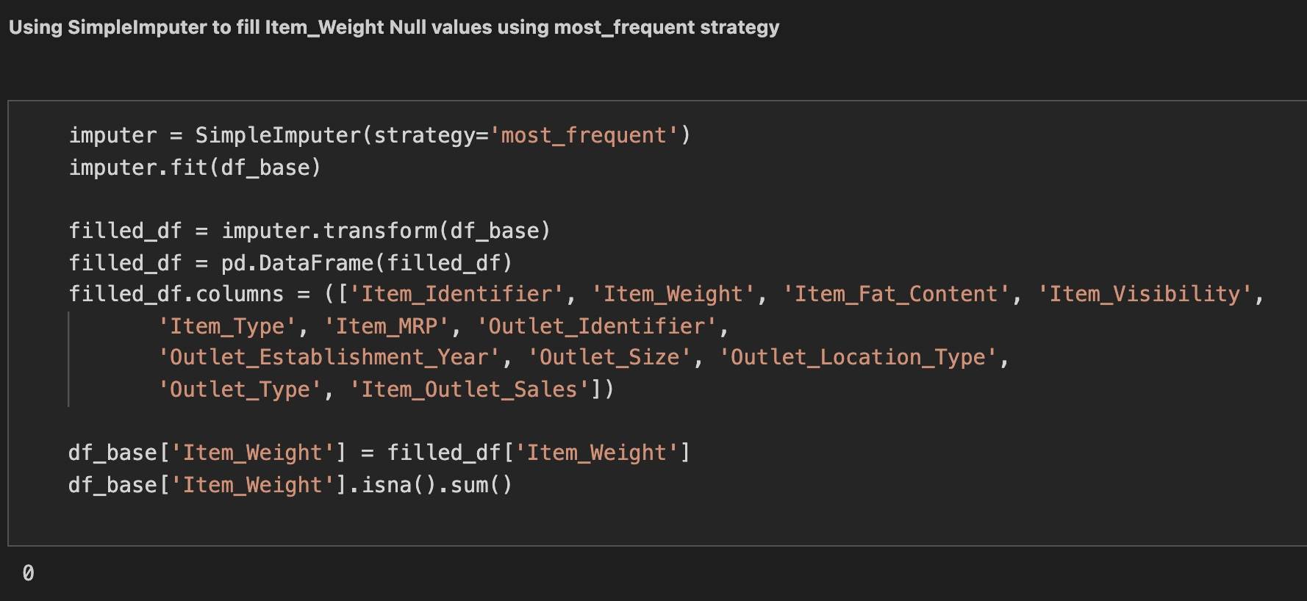
Data Cleaning Cont.
Item_Weight:
Using SimpleImputer
I opted for SimpleImputer with most frequent strategy as it was the best tool available to me at the time
Reflecting with new learning, I could use regression to get better and more meaningful results.

Slide 10
Data Cleaning Cont.
Inconsistencies
Item_Fat_Content
This column contained a number of categorical inconsistencies which were corrected

Slide 11
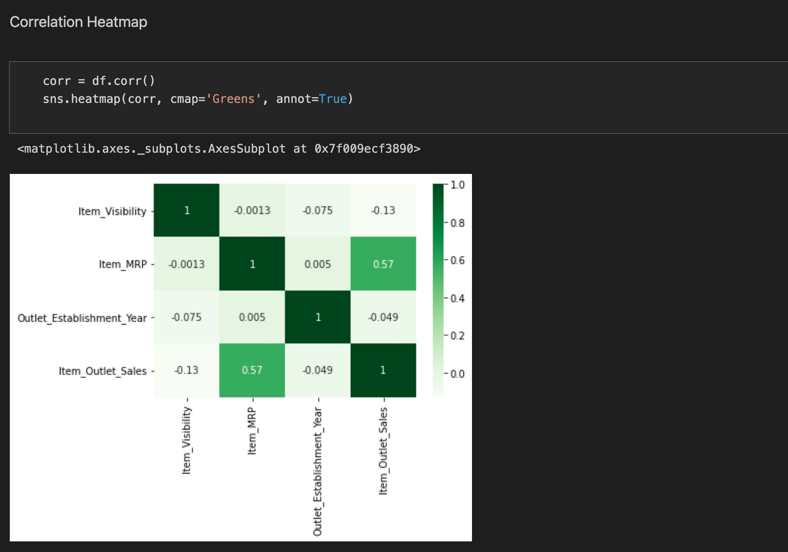
Visuals
Plotting a correlation matrix revealed a moderate positive correlation between Item_Outlet_Sales & Item_MRP

Slide 12
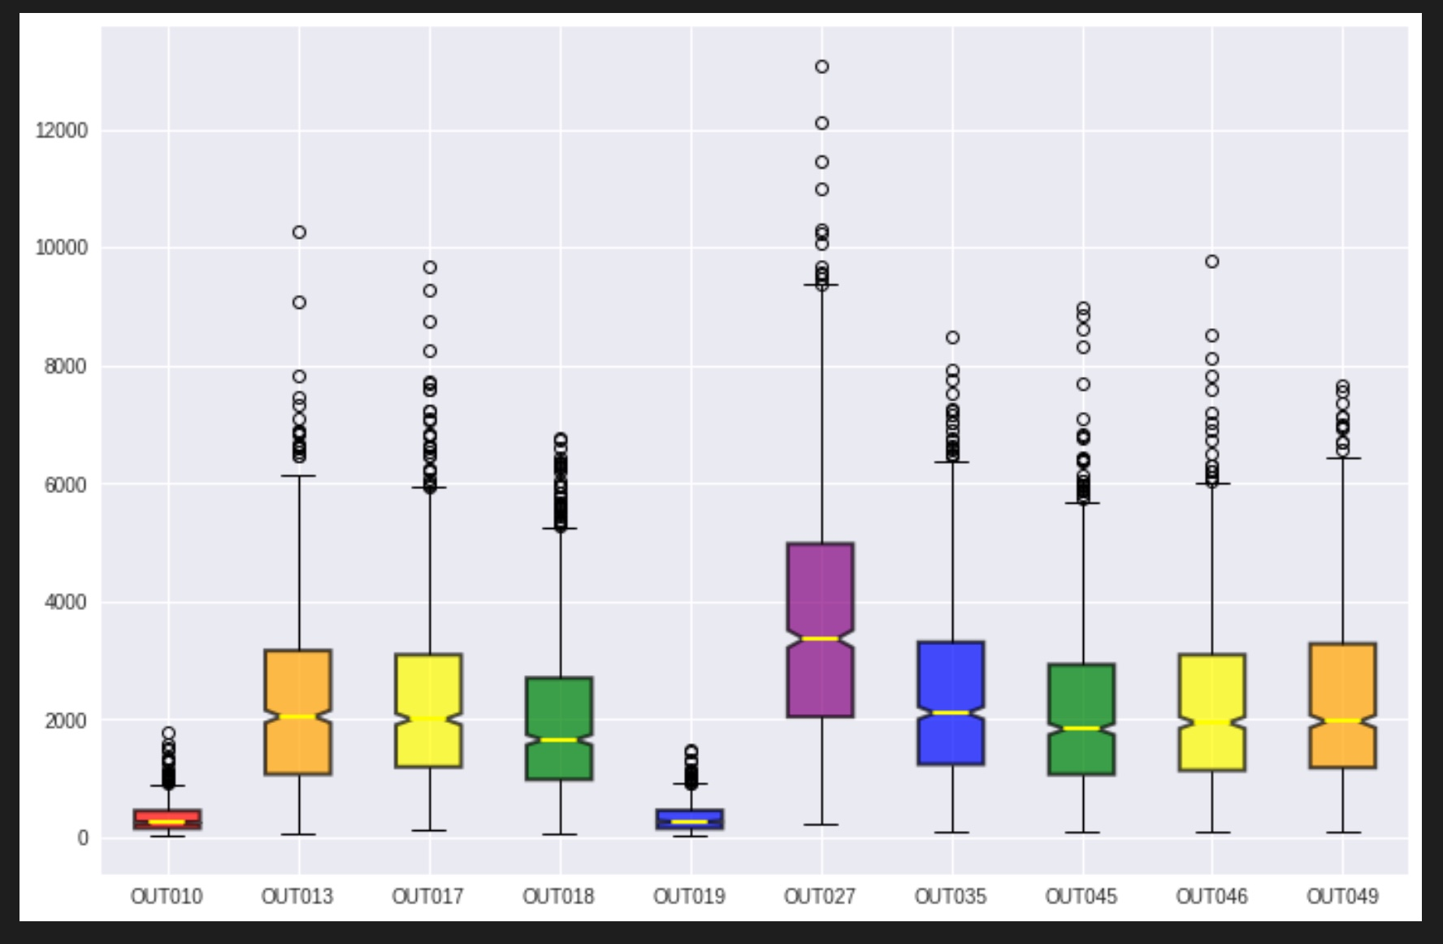
Visuals Cont.
Observed:
Several outliers exist in Totals for Outlet_Item_Sales when grouped by Outlet

Slide 13
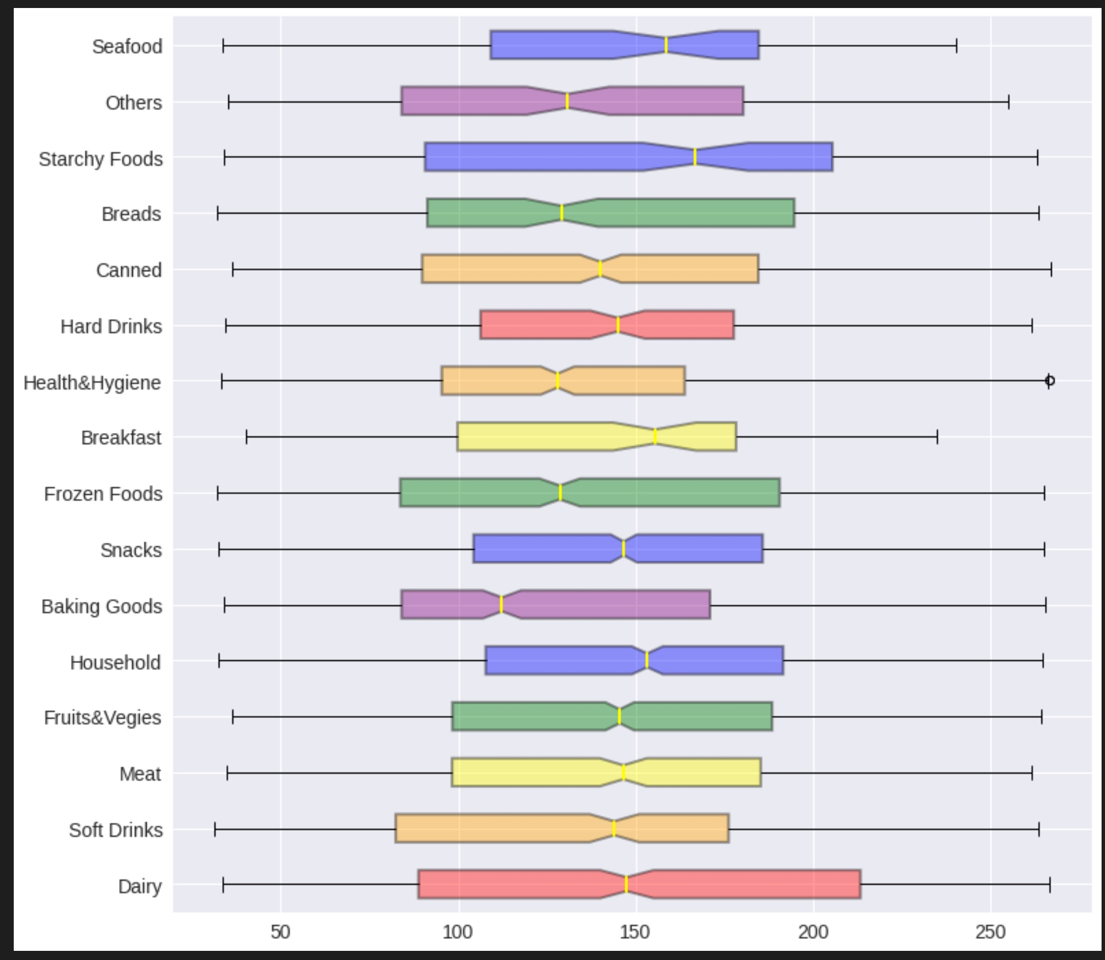
Visuals Cont.
Observed:
No Outliers exist for Outlet_Item_Sales when grouped by Item_Type which is expected. The Means for most groups are generally close together with few exceptions

Slide 14
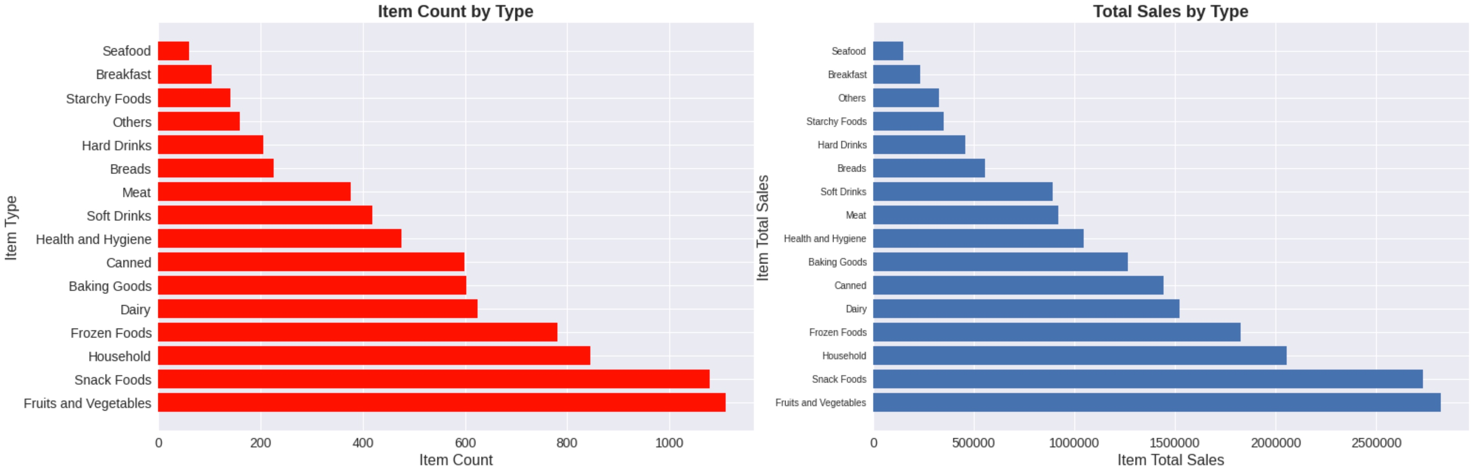
Visuals Cont.
Observed:
Fruites & Vegetables and Snack Foods Item_Types have relatively higher Total_Item_Sales compared with other Item_Types, They also have relatively higher unique items count each which could suggest that Item_Type that have higher variety have higher sales

Slide 15
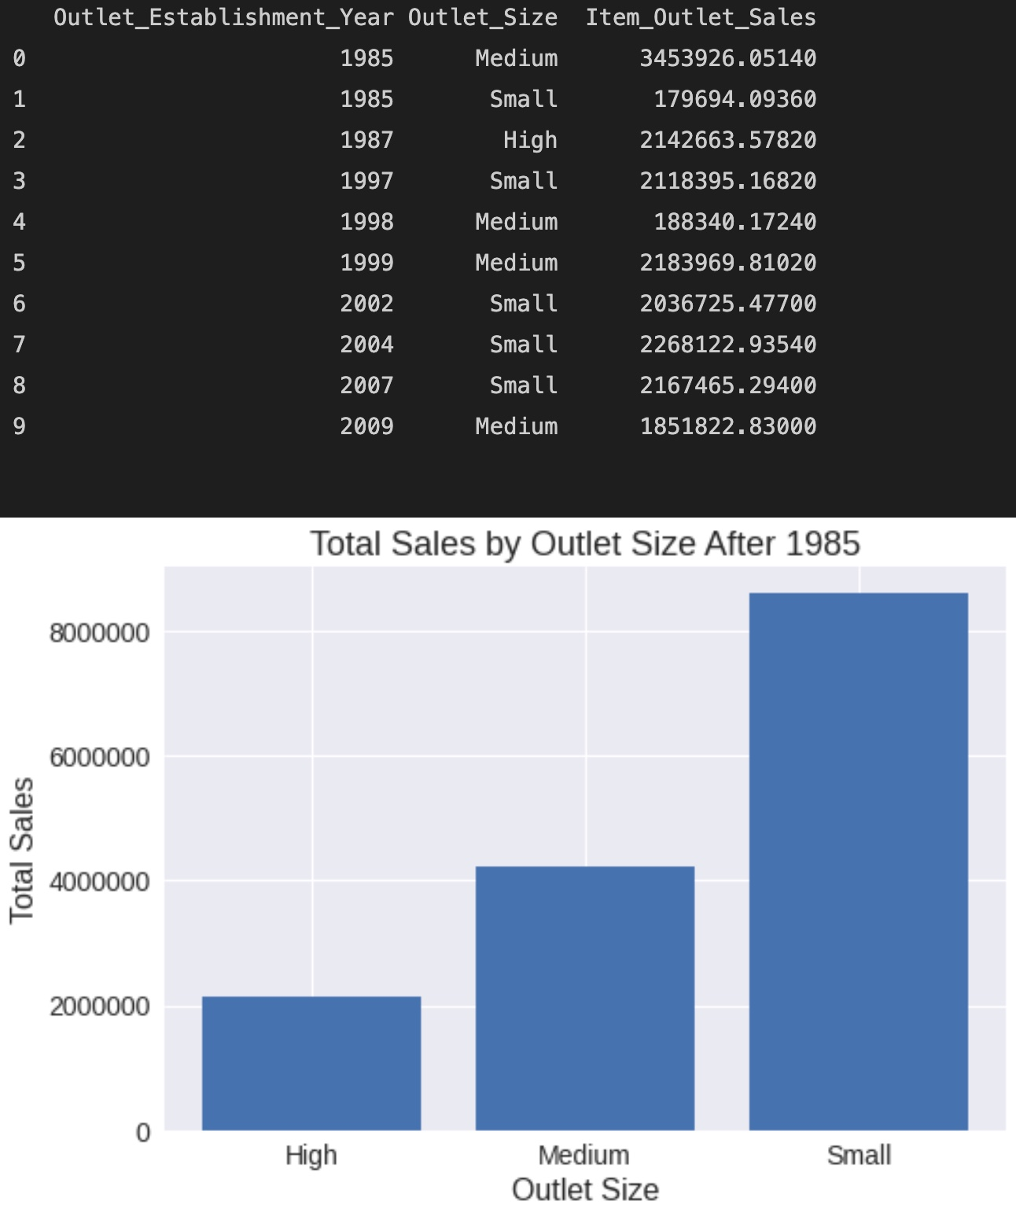
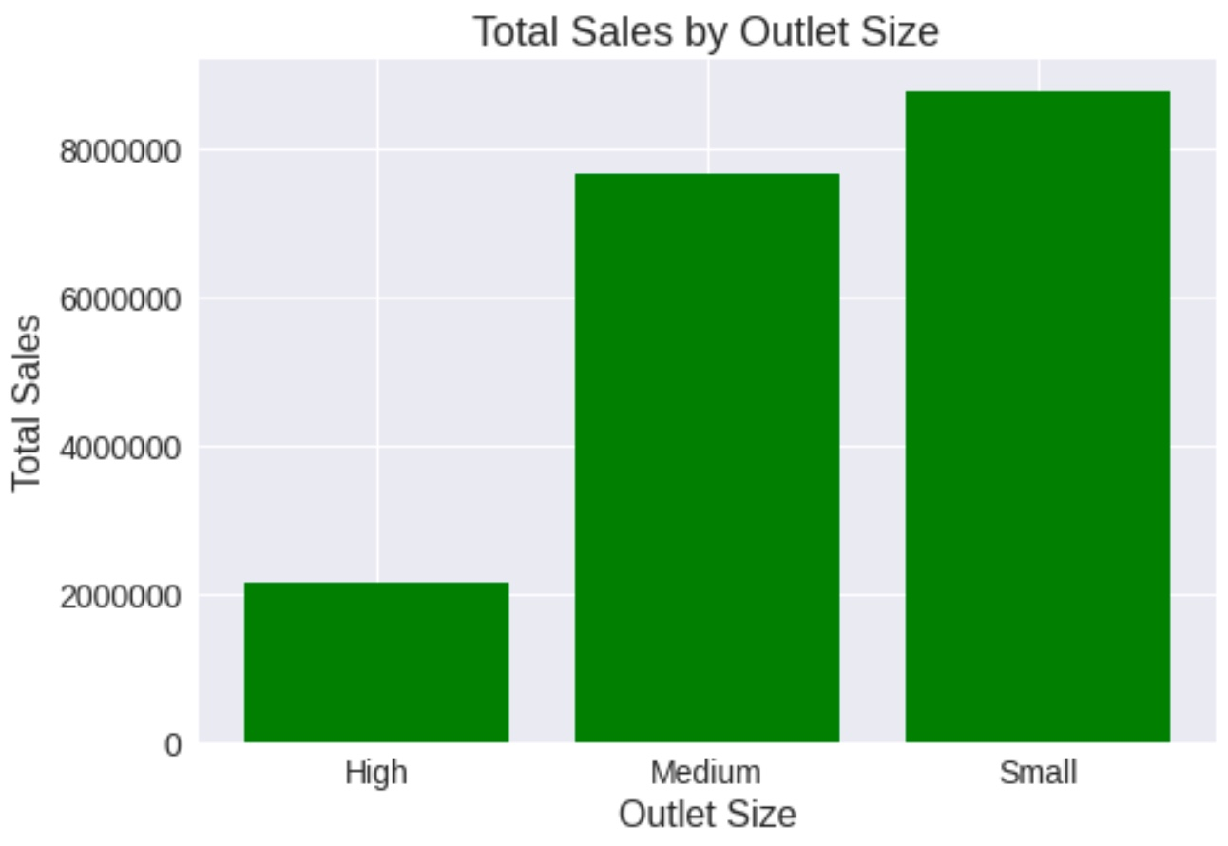
Visuals Cont.
Observed:
Small Outlet_Size have higher total sales compared to other Outlet_Size categories.
Mean sales for this category is lower than others though

Slide 16
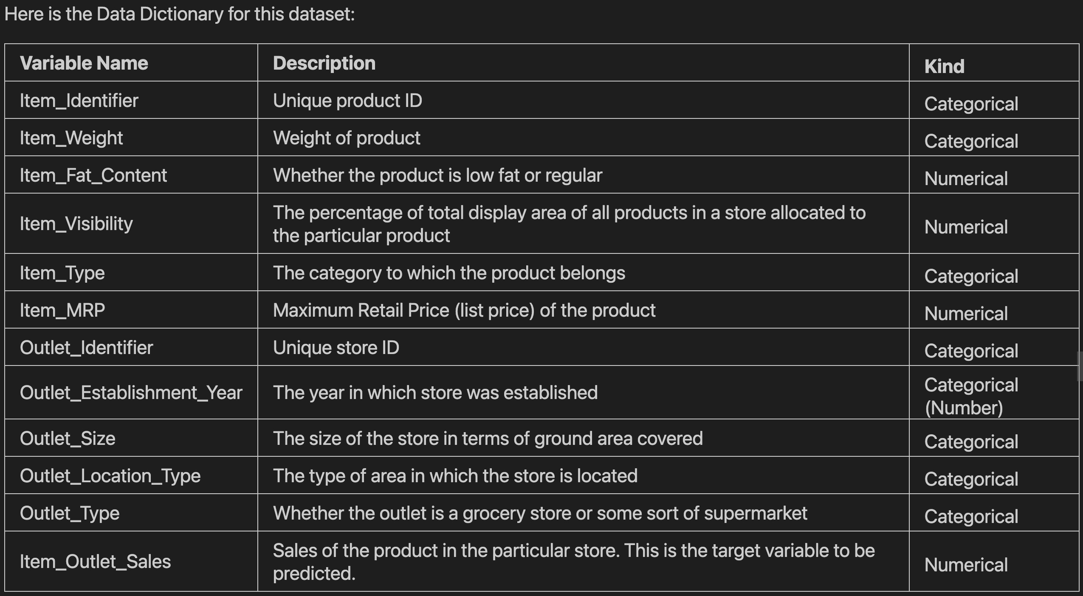
Linear Regression Preprocessing – Option 1
The data set contains several value types both categorical & numerical thus requires processing prior to running any models on it

Slide 17
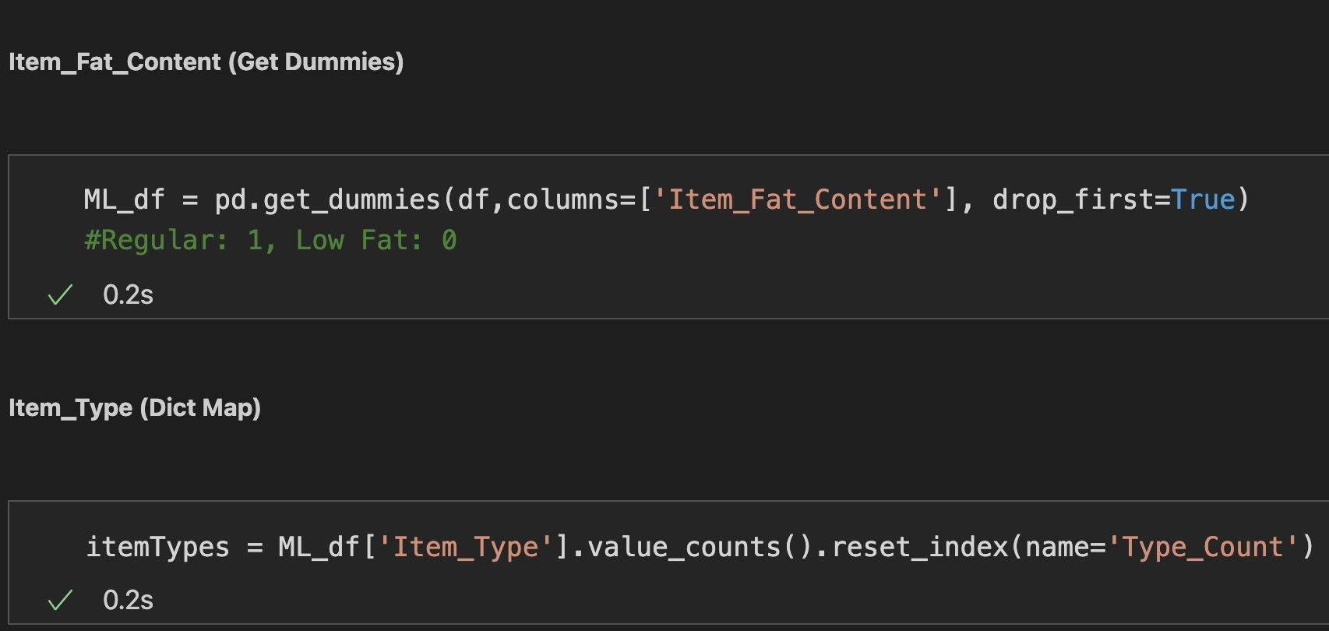
Linear Regression Preprocessing – Option 1

Slide 18
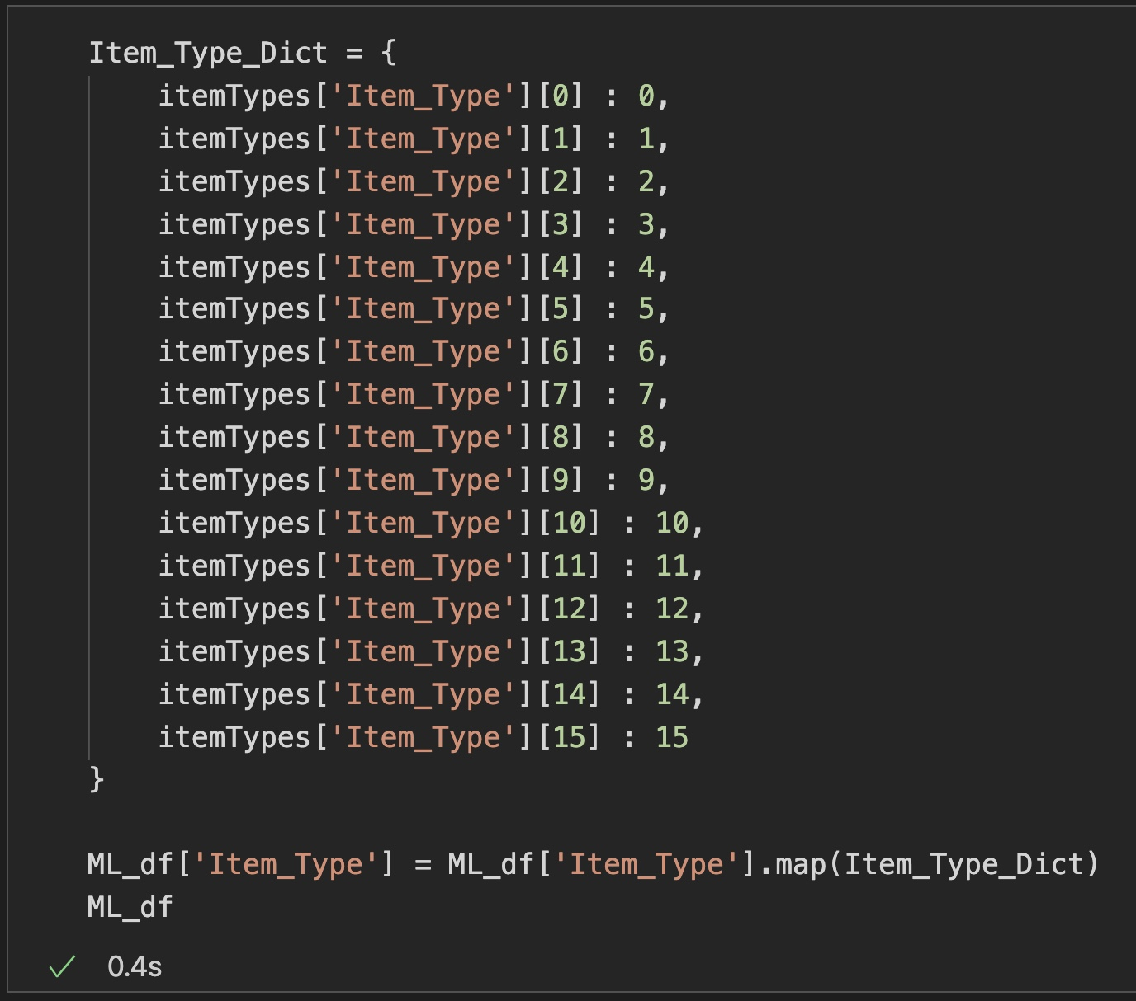
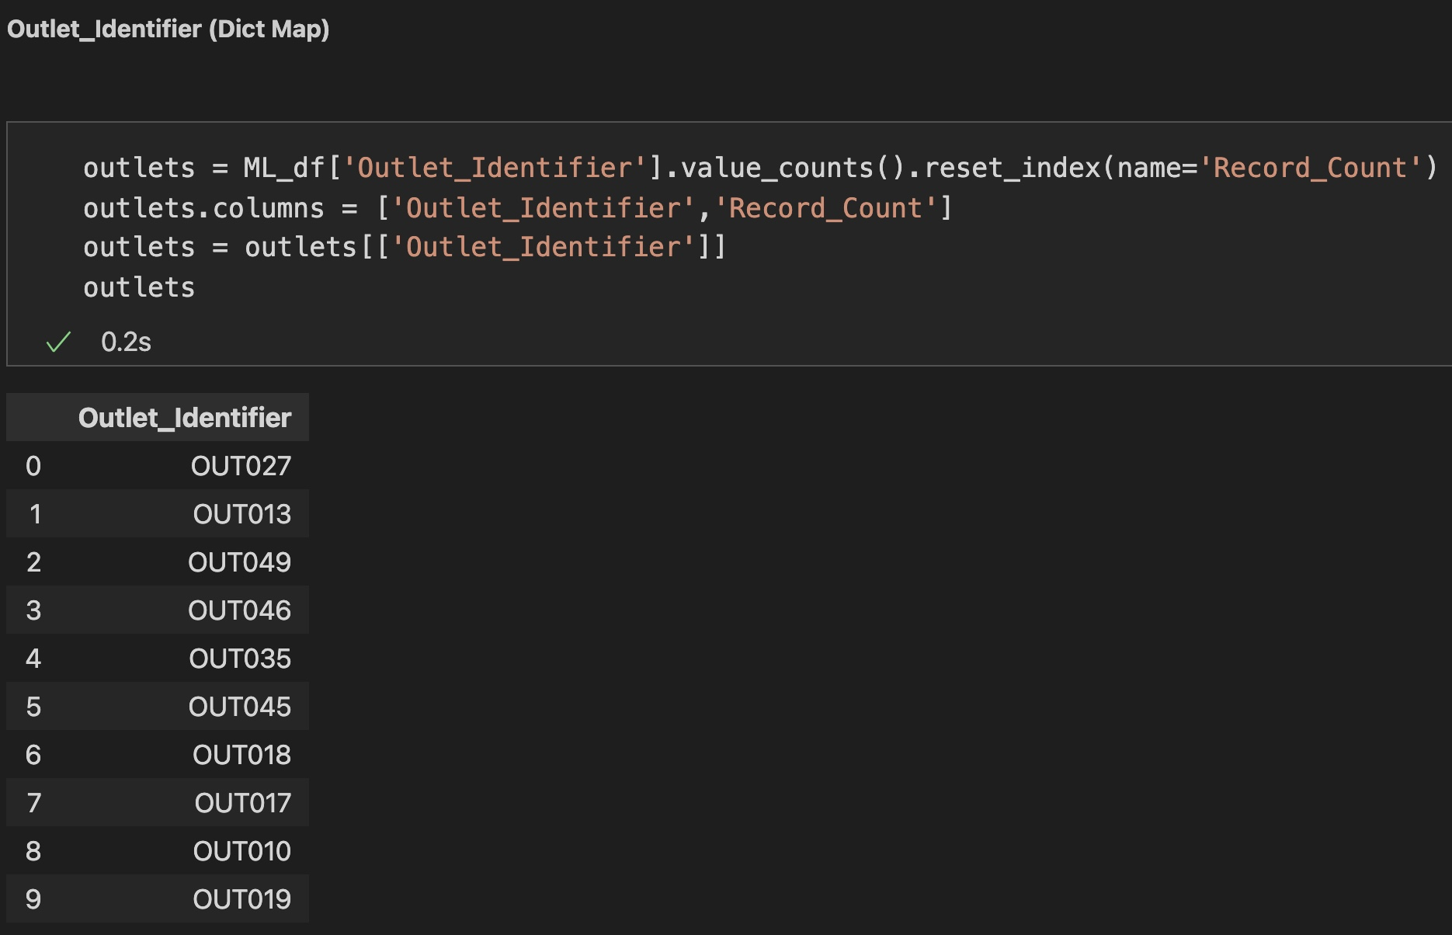
Linear Regression Preprocessing – Option 1

Slide 19
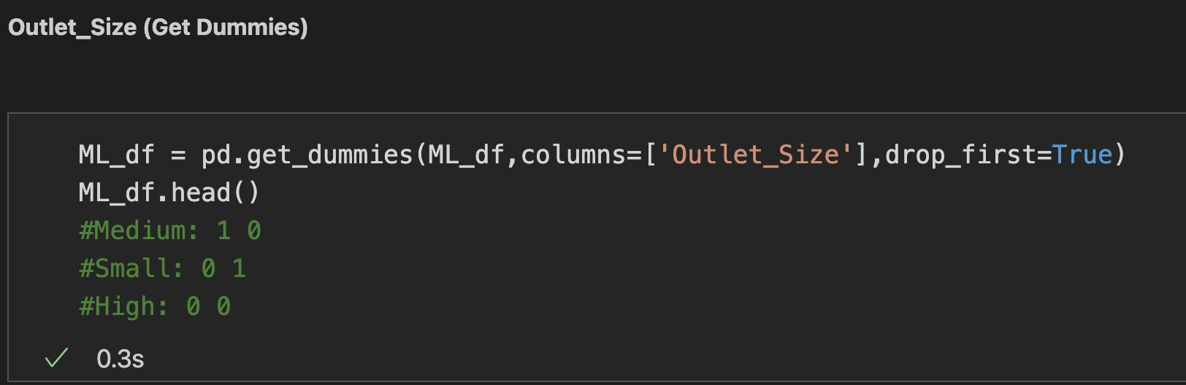
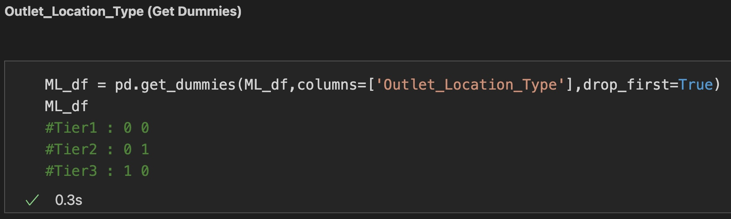
Linear Regression Preprocessing – Option 1

Slide 20
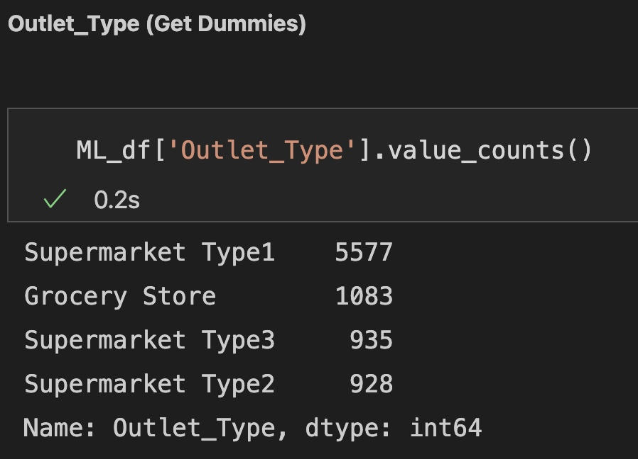
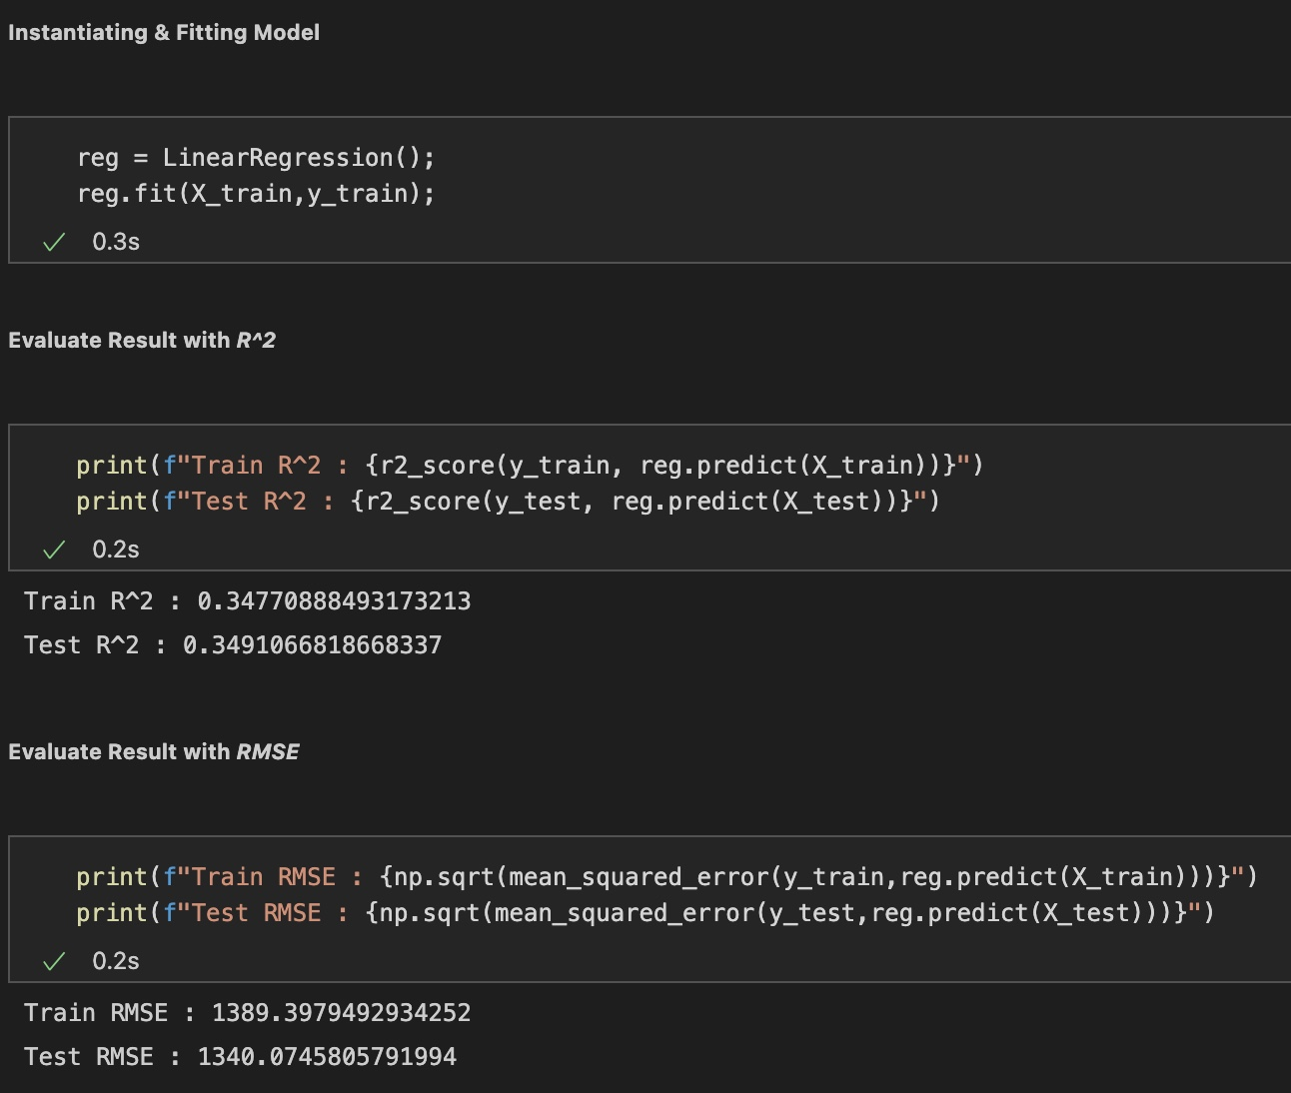
Linear Regression Preprocessing – Option 1

Slide 21
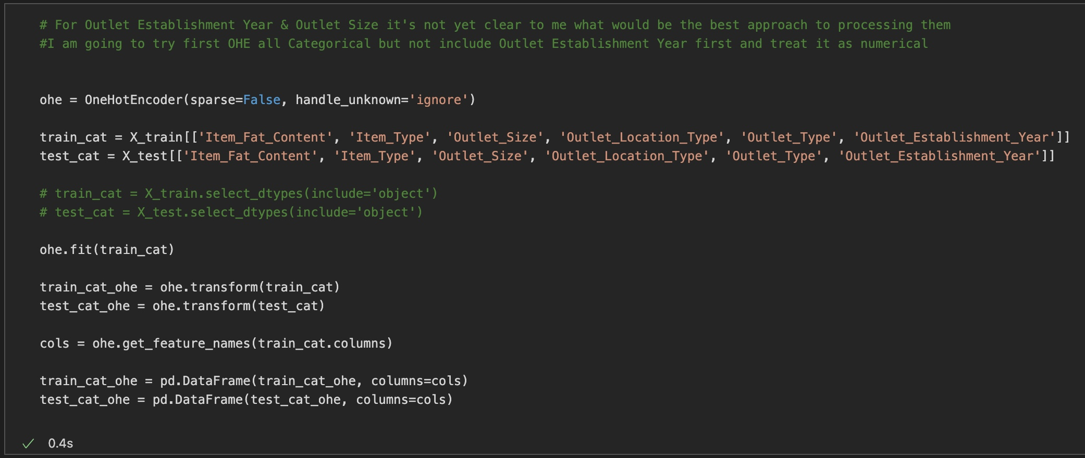
Linear Regression Preprocessing – Option 2

Slide 22
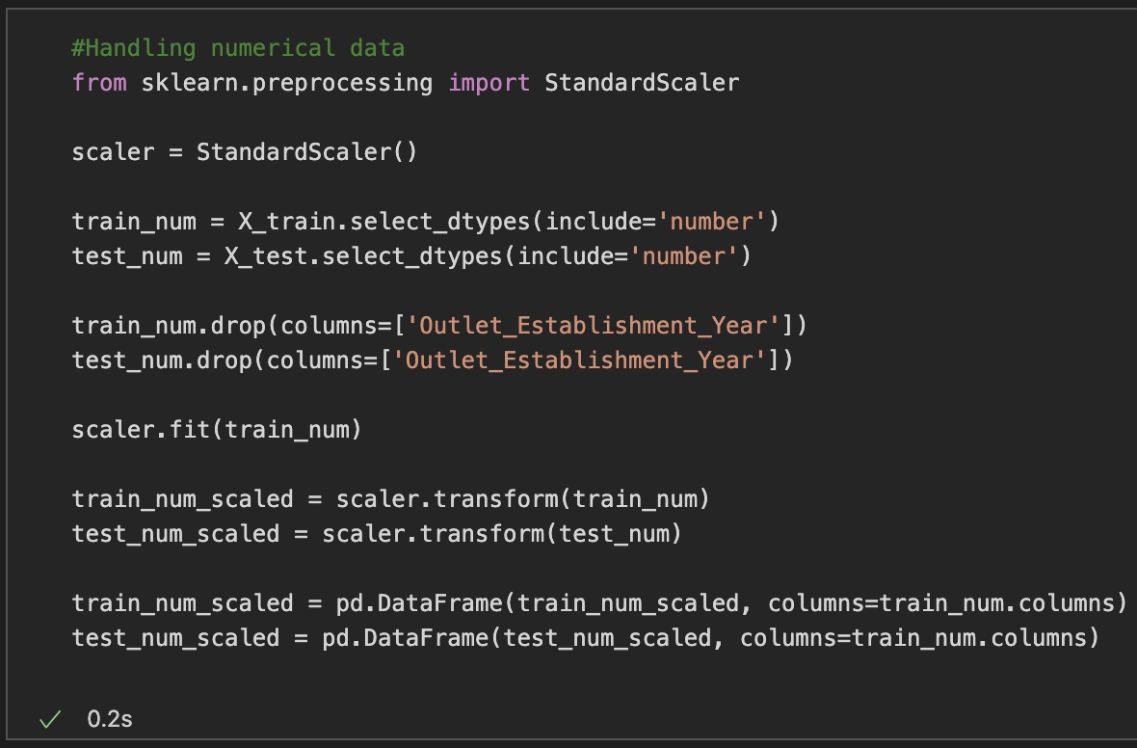
Linear Regression Preprocessing – Option 2

Slide 23
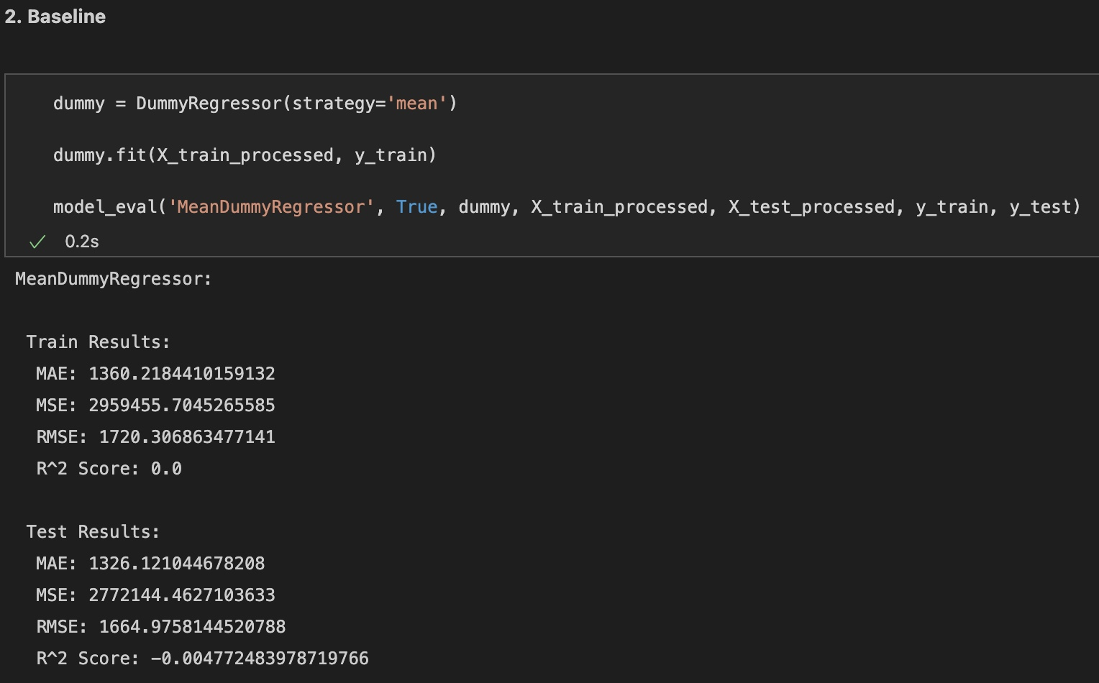
Linear Regression Preprocessing – Option 2

Slide 24
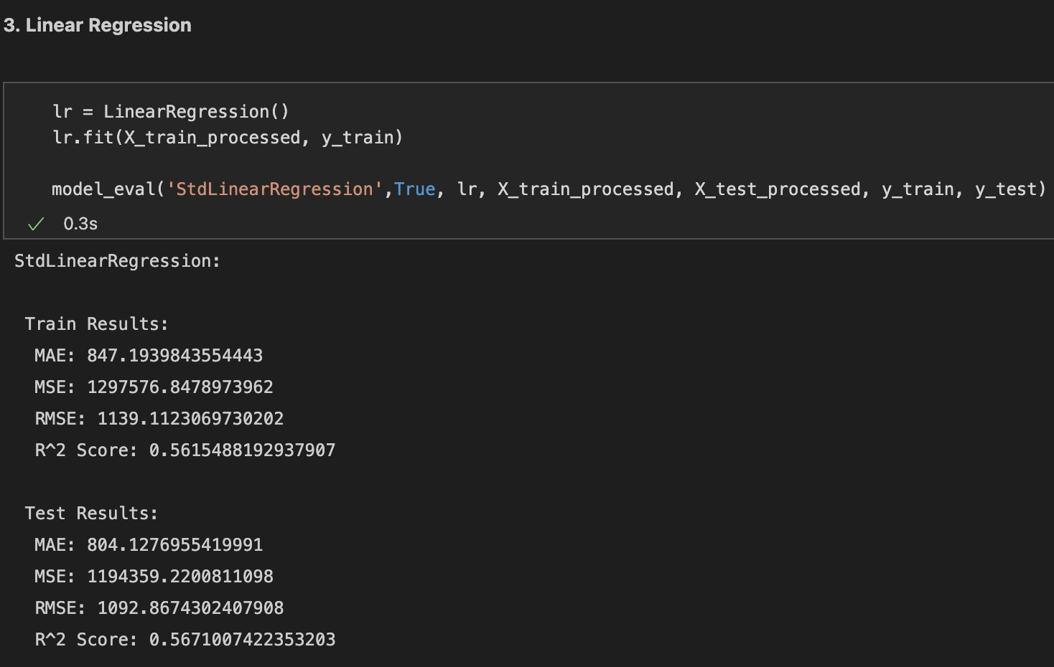
Linear Regression Preprocessing – Option 2

Slide 25
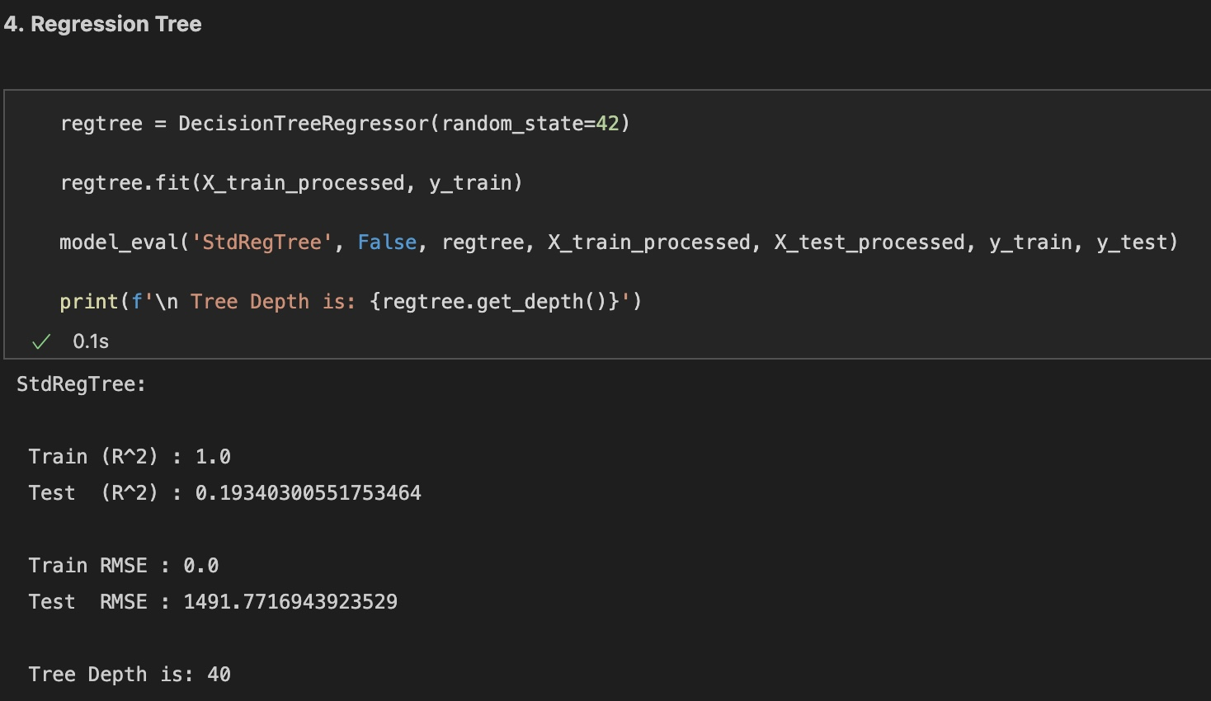
Regression Tree

Slide 26
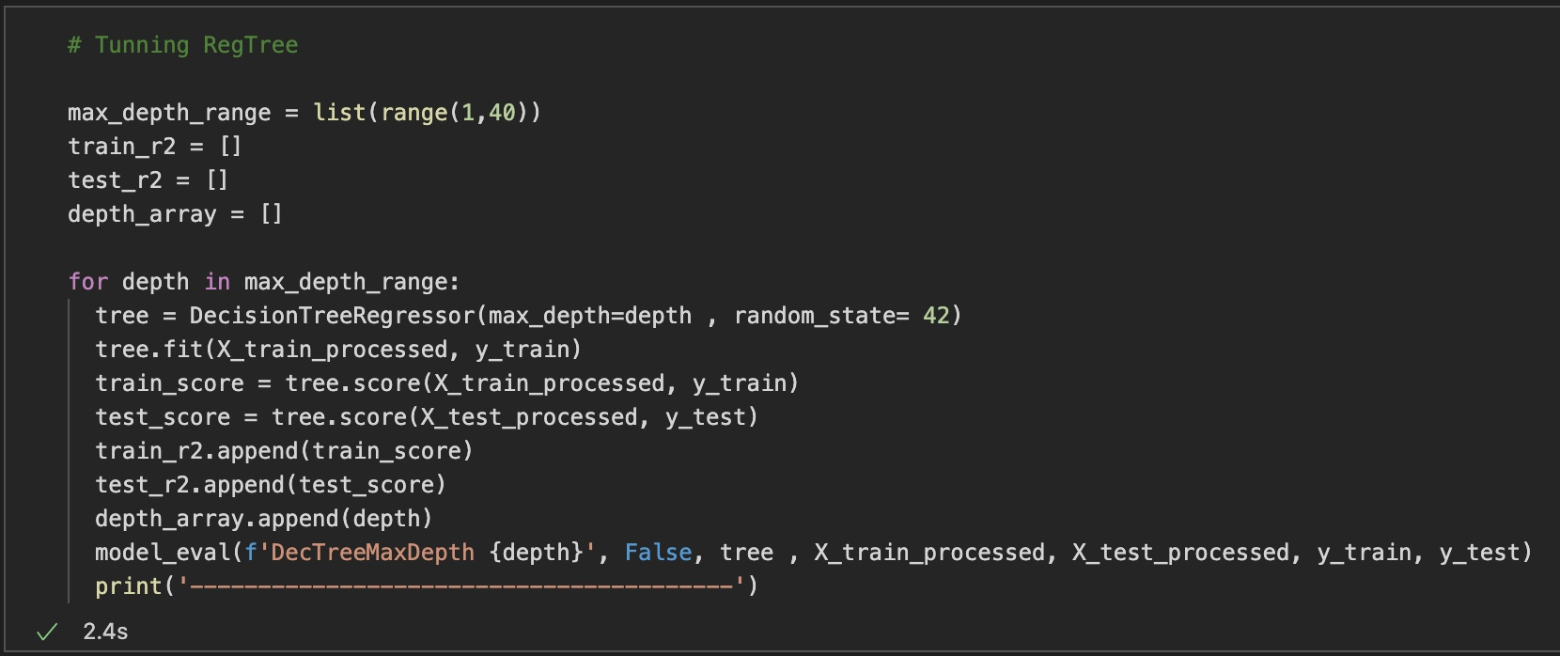
Regression Tree Cont.

Slide 27
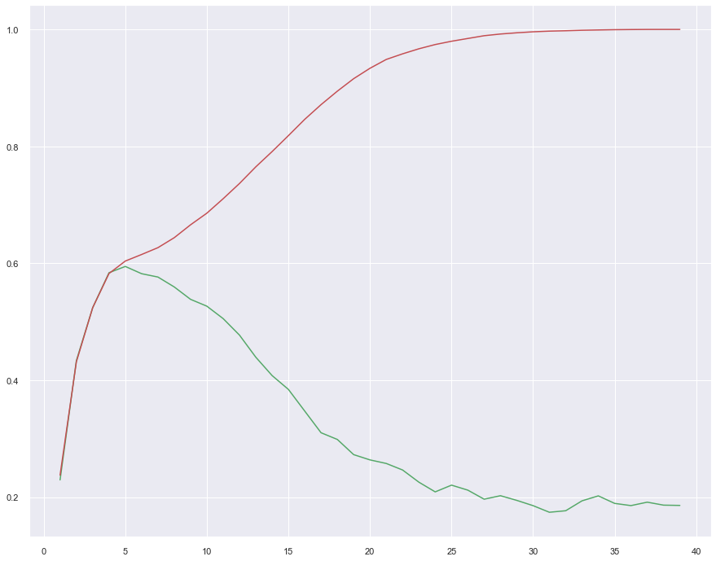
Regression Tree Cont.
Observed:
Depth 5 yielded the best results for the Decision Tree Regressor and beyond this depth both Variance and Bias start to increase

Slide 28
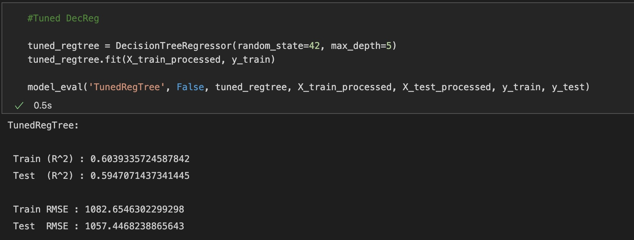
Regression Tree Cont.

Slide 29
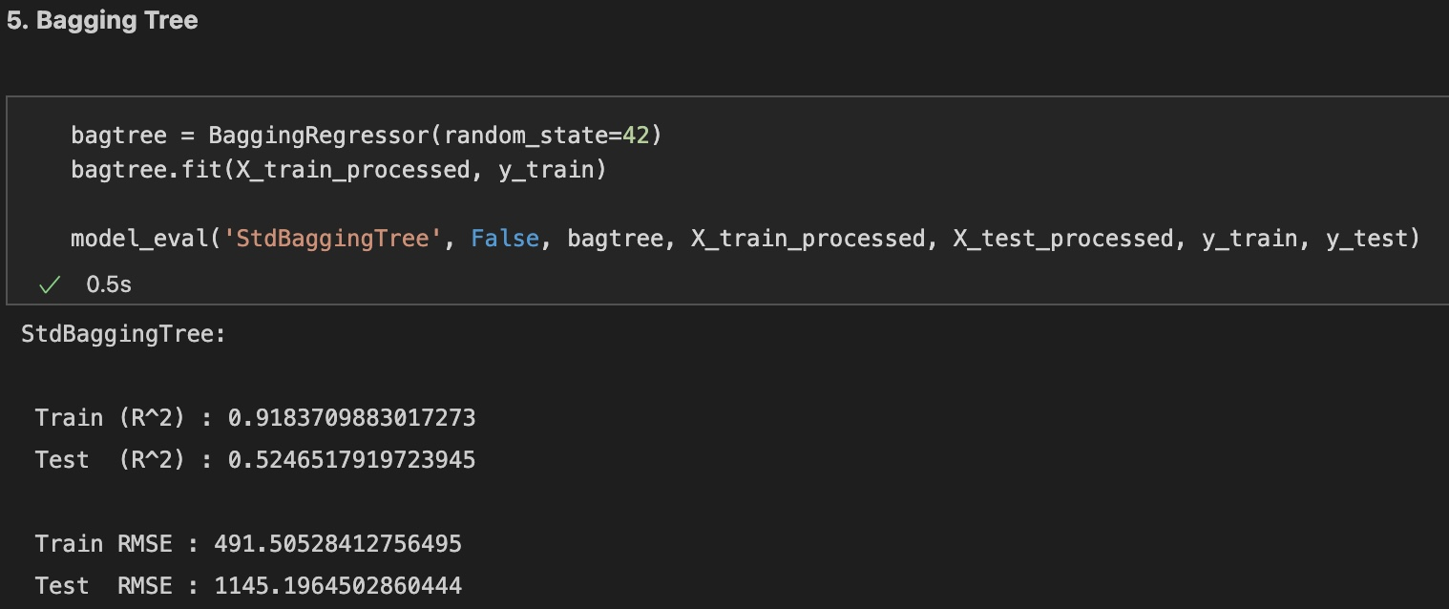
Bagging Tree Regressor

Slide 30
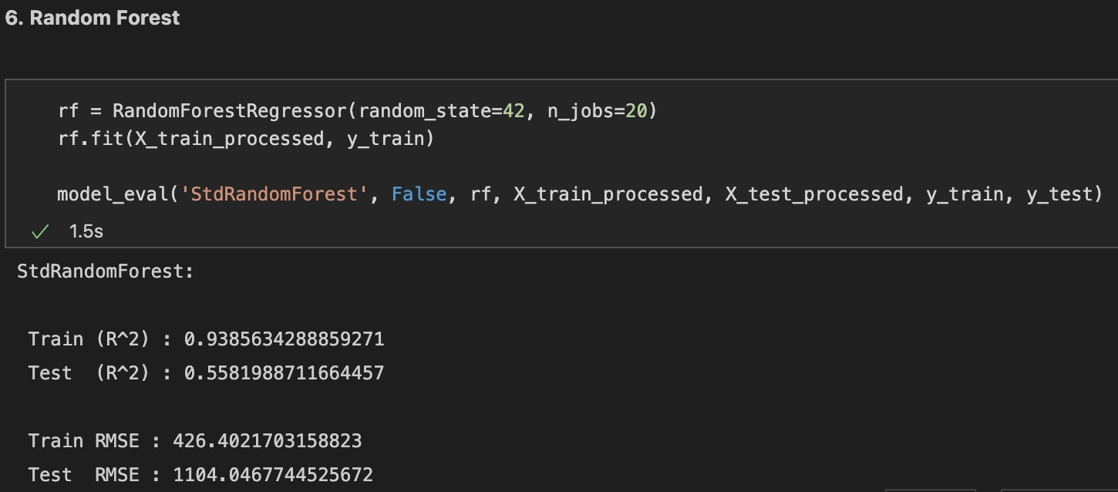
Random Forest Regressor

Slide 31
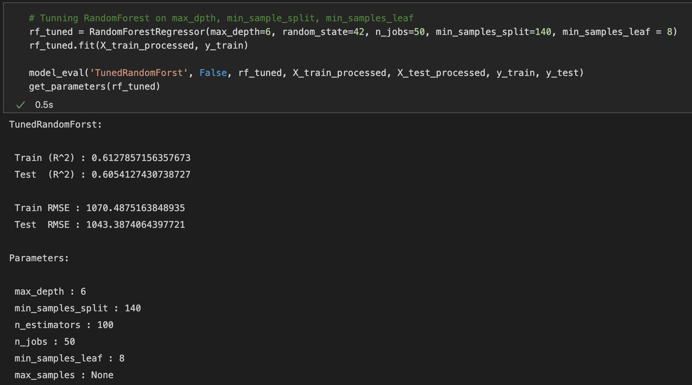
Random Forest Regressor Cont.

Slide 32
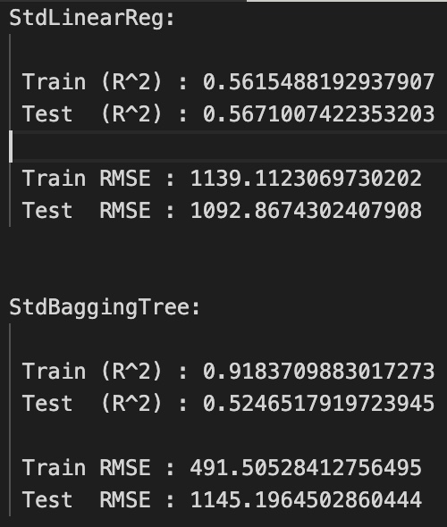
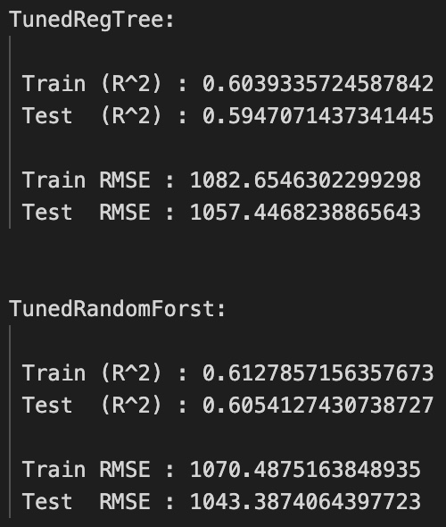
Model Scores Comparison

